Slide 1
IFB299 Presentation
Harry Perkins – N9751670
Liam Luhrs – N9744932
Wen Yang – N9345710
Jahred Mauricio – N9740805
Noel Martinez – N10076654

Slide 2
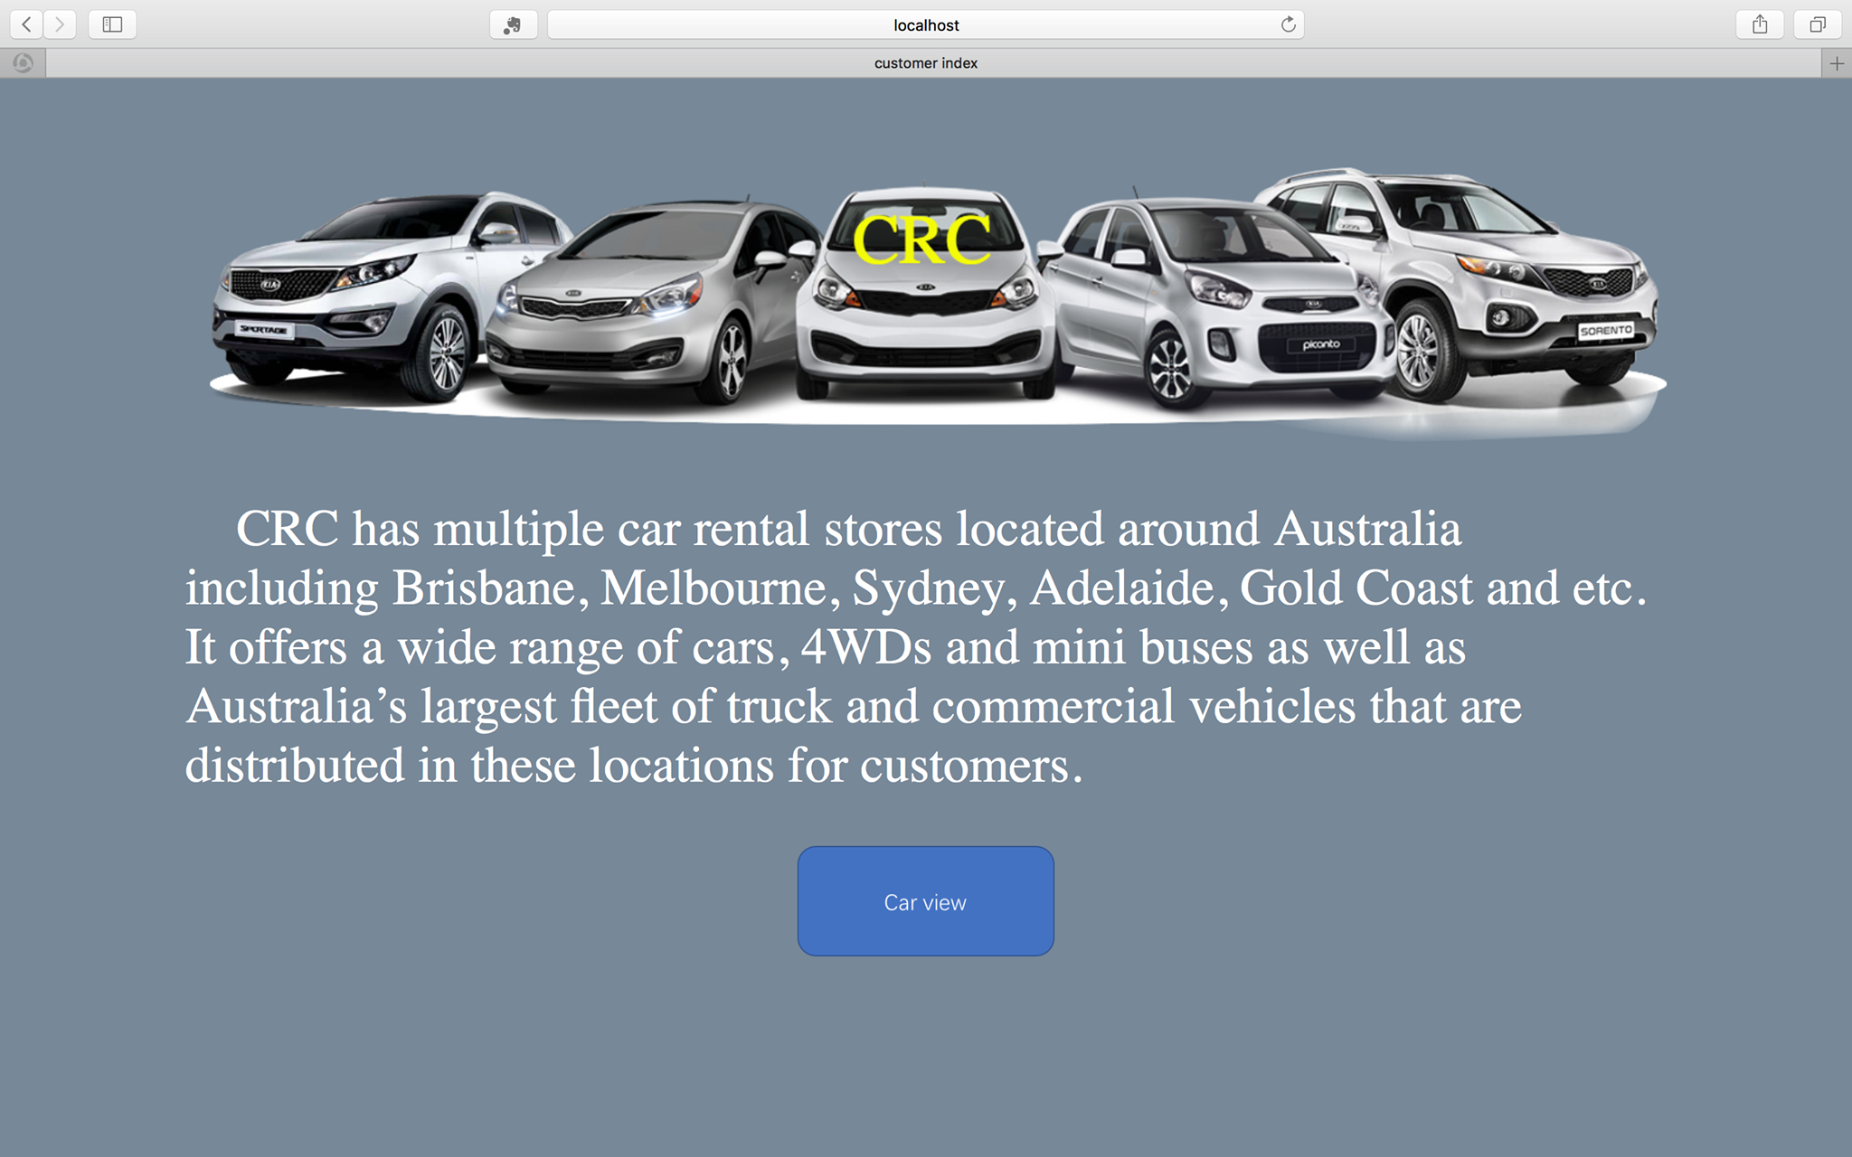
Welcome Page

Slide 3
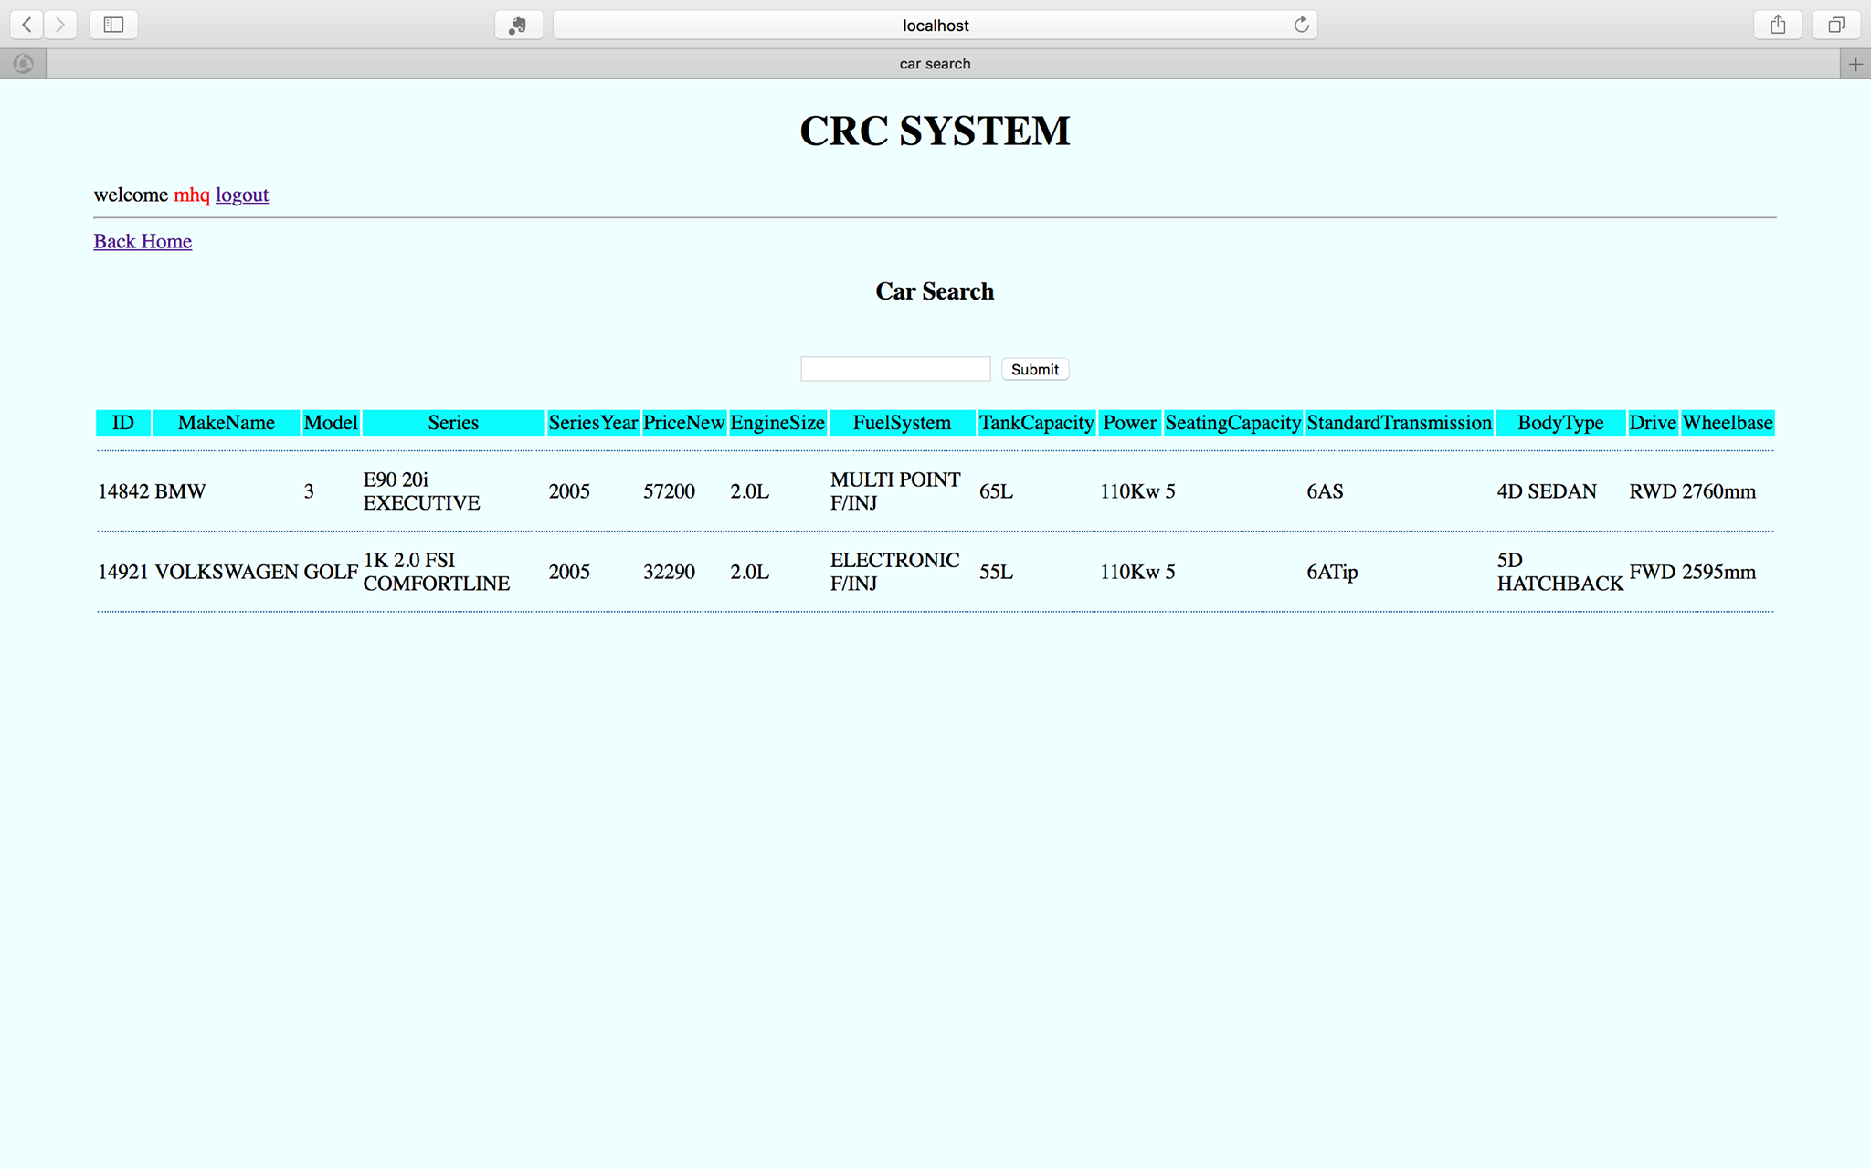
Vehicle Search

Slide 4
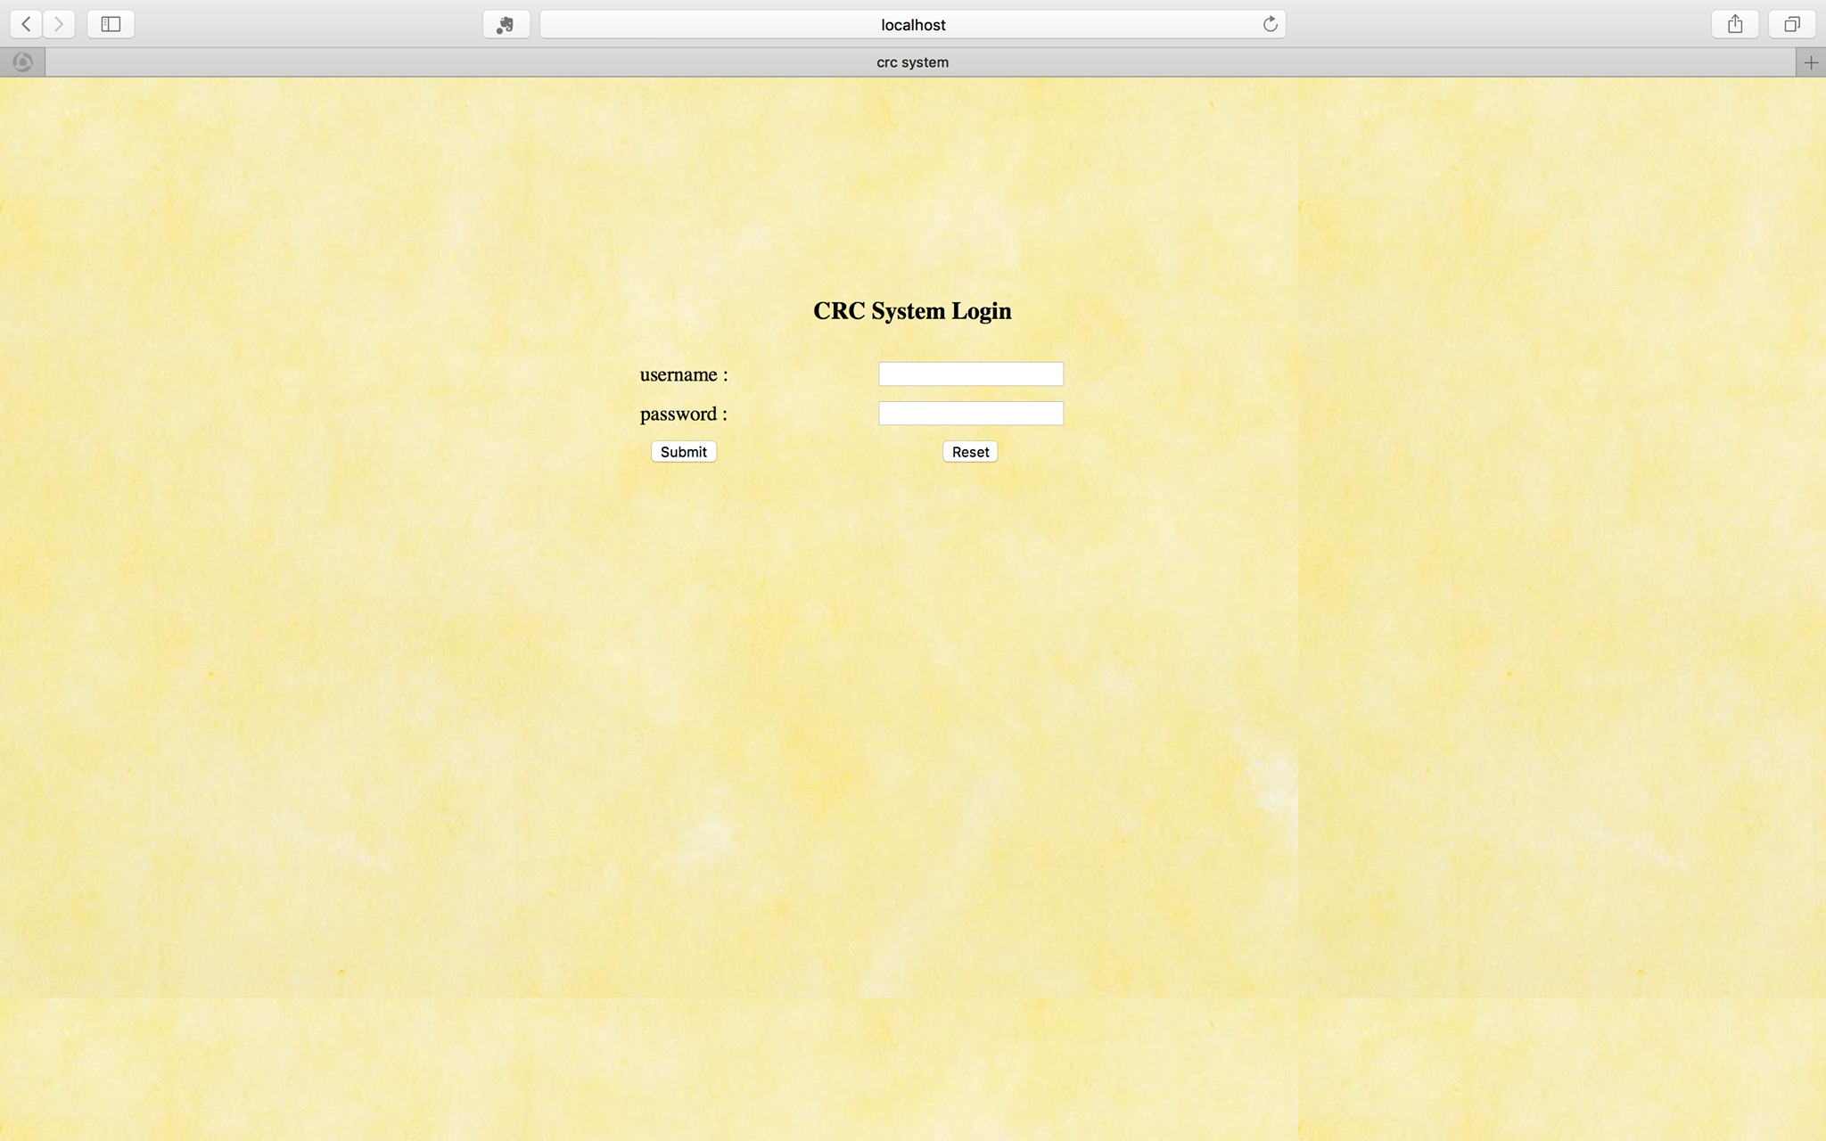
Login Page

Slide 5
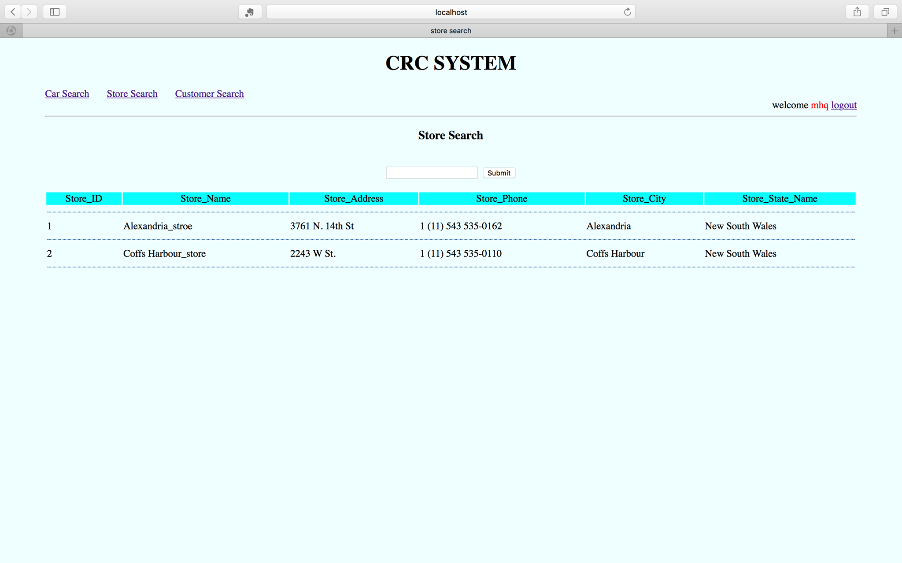
Store Search

Slide 6
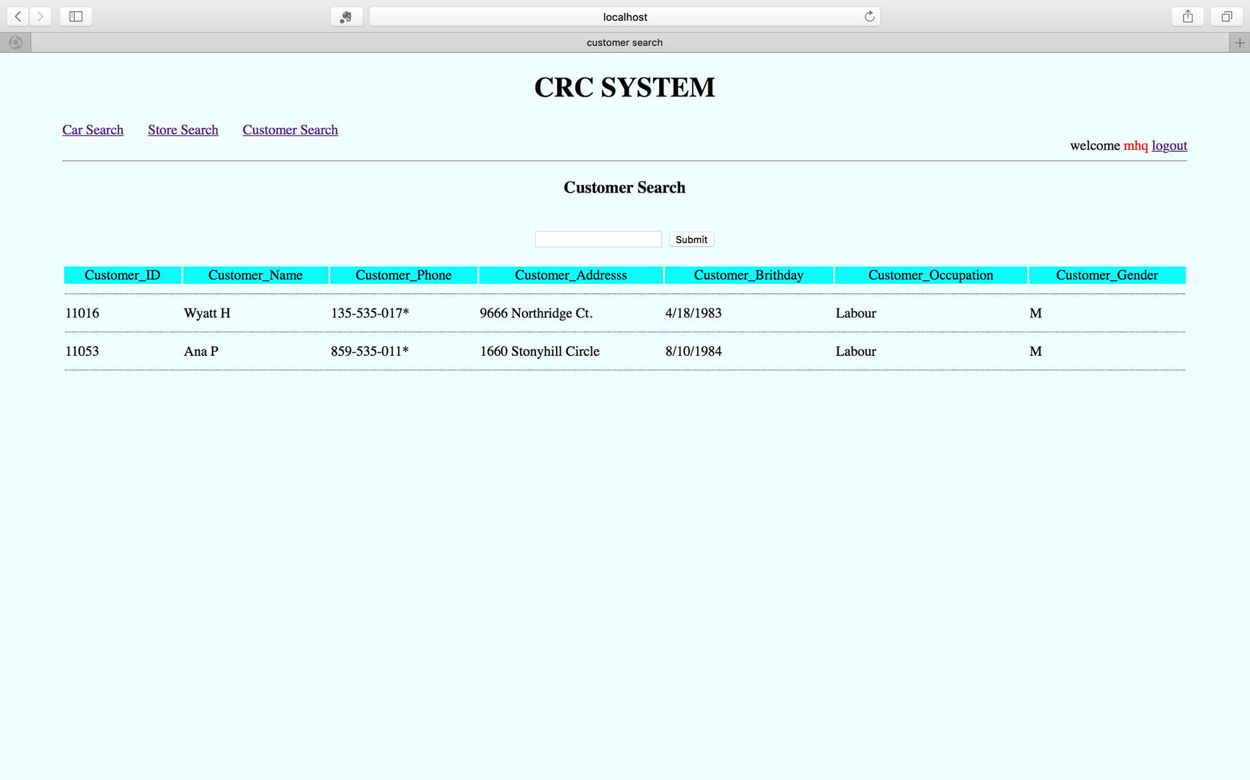
Customer Search

Slide 7
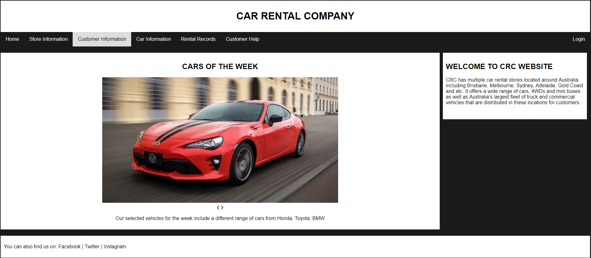
Welcome Page 2.0

Slide 8
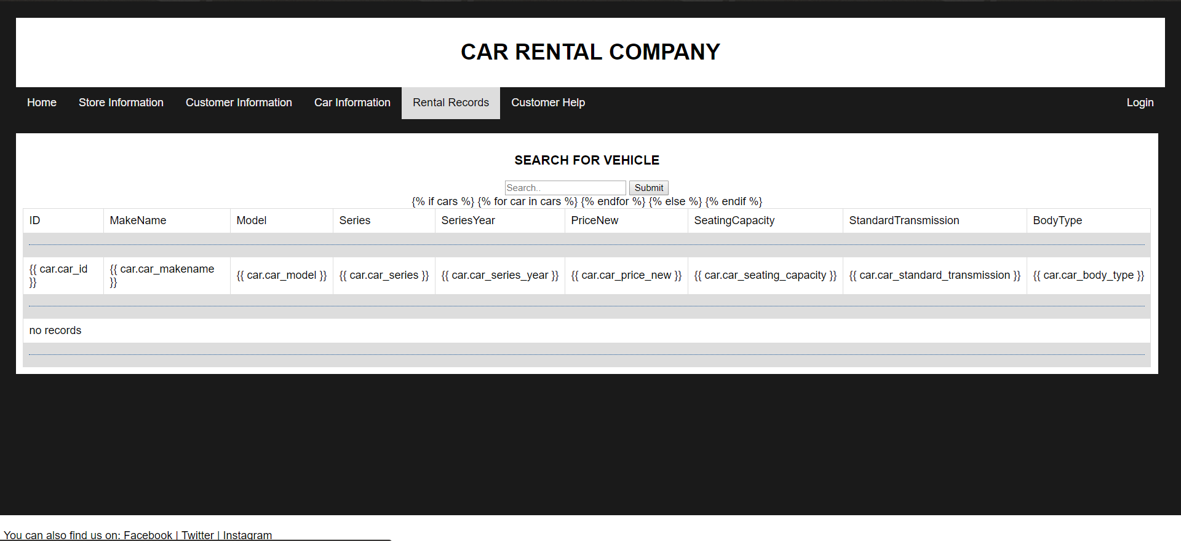
Vehicle Search 2.0

Slide 9
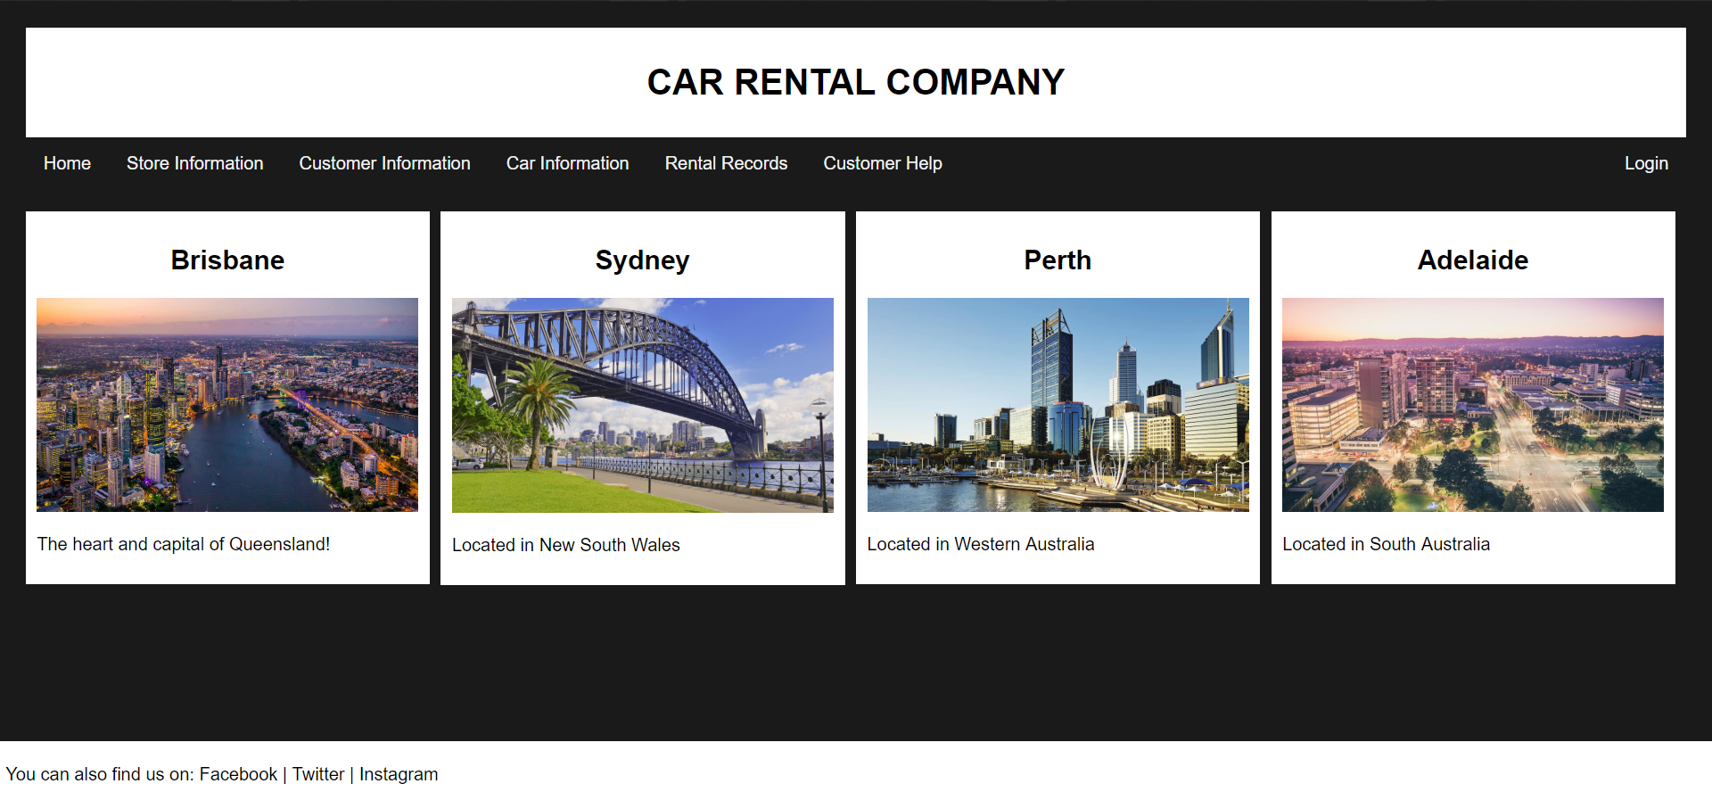
Store Search 2.0

Slide 10
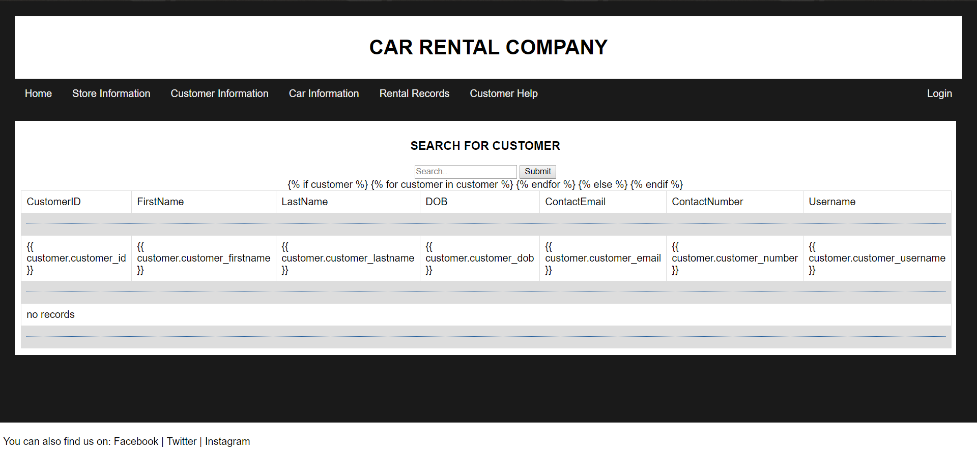
Customer Search 2.0

Slide 11
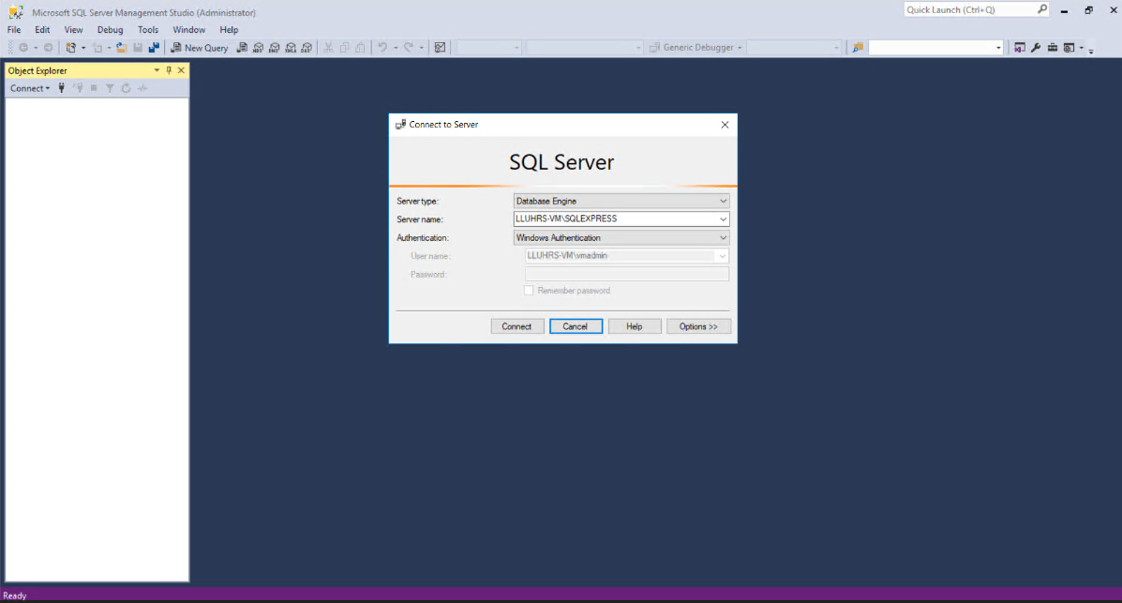
Database and Server
Windows 10 VM
SQL Server

Slide 12
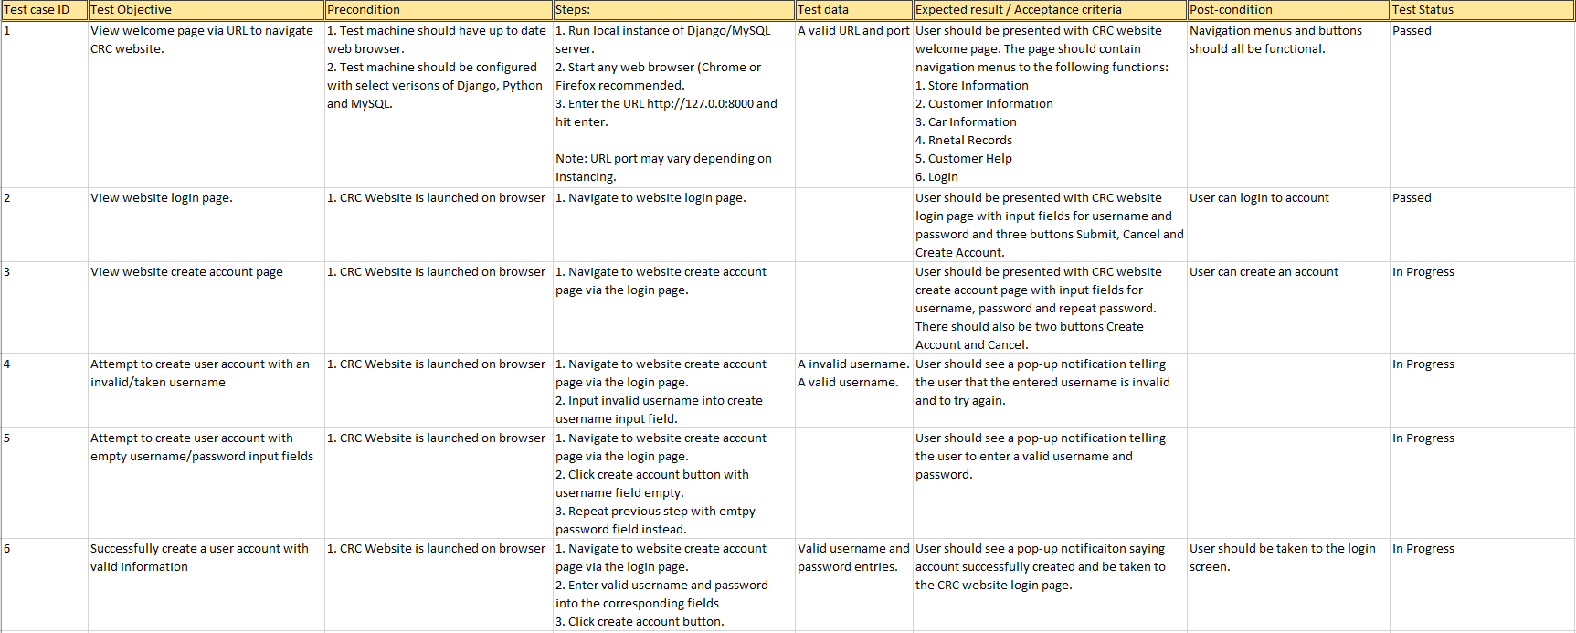
Test Cases

Slide 13
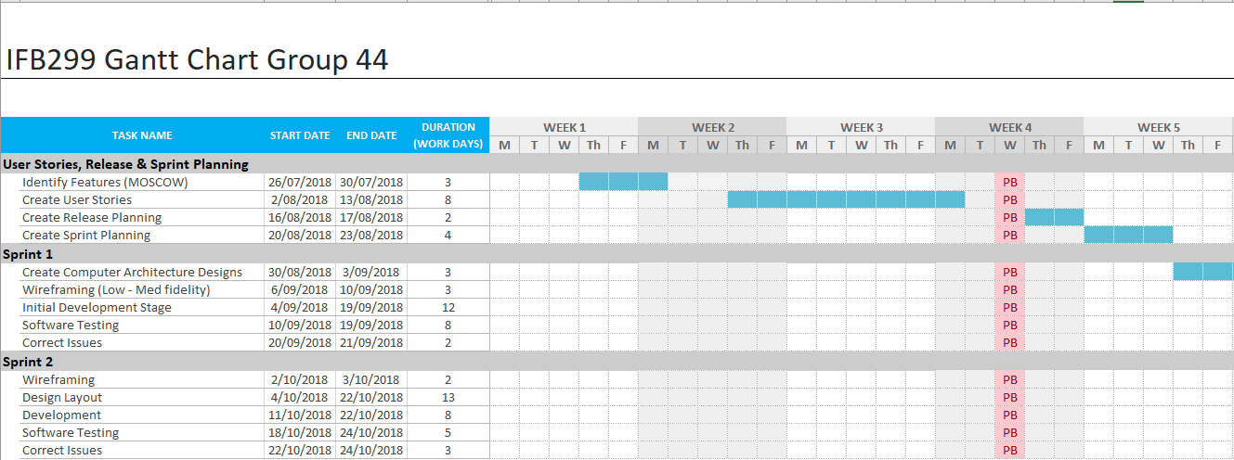
Gant Chart Week 1-5

Slide 14
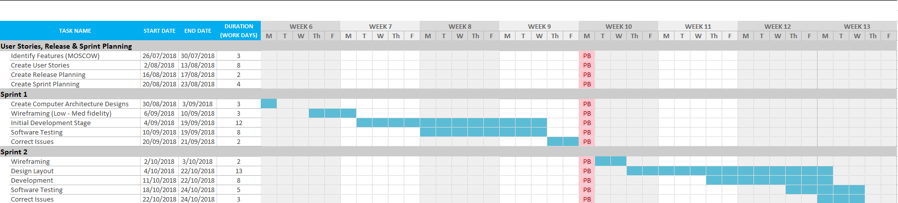
Gant Chart Week 6-13

Slide 15
Scrum

